Slide 1
IoT Health Monitoring System
Vacca Andrea Francesco
Mohamed Mahmoud Mohamed Zaghloul Saad
Thiam Papa Serigne Mbacke

Slide 2
Table of Content
Introduction
Interfacing between smartwatch and Esp32 via BLE
Interfacing between ESP32 and ESP8266 based on client location
Results and conclusions
Data Managing on Cloud

Slide 3
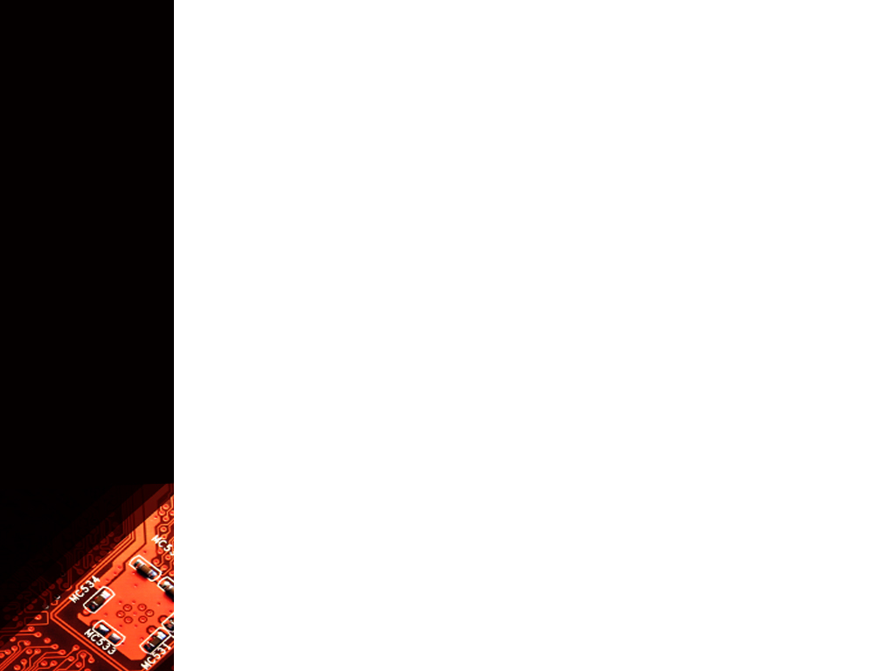
Introduction
This project has as its application context what might be a nursing home
for the elderly where there is a need to constantly monitor the various vital
parameters of the residents over time.
This translates into constant monitoring of these variables on a continuous basis.
The data obtained are then transferred, analyzed, and processed in or-
der to contextualize the data so as to understand whether the data obtained
indicate a dangerous situation, or is it just a normal condition of the patient
due to the physical context
The project also aims to adapt to different situations, for example, it adapts its communication protocol based on the subject's location, or based on the data it is receiving.

Slide 4
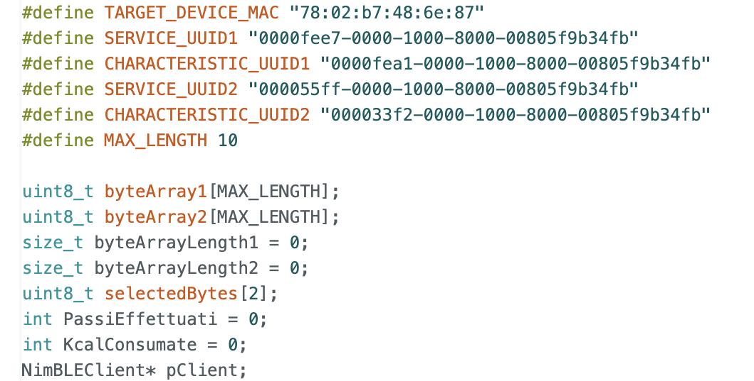
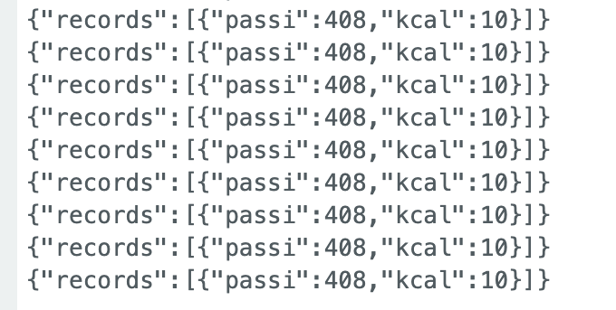
Interfacing between smartwatch and Esp32 via BLE
In this first part, the project operation is based on receiving the information contained within the UUID services, discarding the useless bytes and transforming the information into a JSON file.
This is possible if we first connect to the Bluetooth device and search with a preliminary study which are the services and characteristics of our interest.

Slide 5
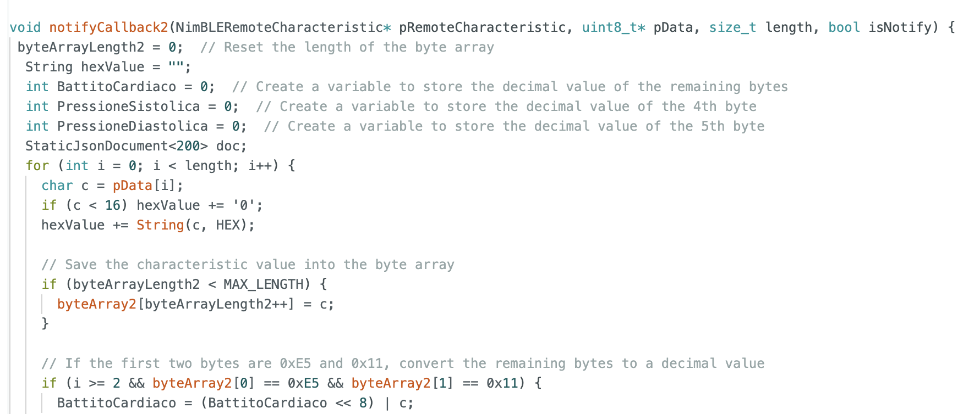
Interfacing between smartwatch and Esp32 via BLE
The two functions work in the same way in parallel, but by analysing different data.
Both receive the entire byte array of the feature and, depending on the data, remove the bytes of unnecessary information and process the remaining bytes by converting them from a hexadecimal to a decimal numeric format.
Lines of code are implemented in each function to send data at fixed time intervals, for convenience a time of 5 seconds was chosen.
After this we chose to create a JSON object containing a label that identifies the data and its values.
This approach was used because data in this format is easily manipulated and allows it to be transferred from one device to another quickly and easily.

Slide 6
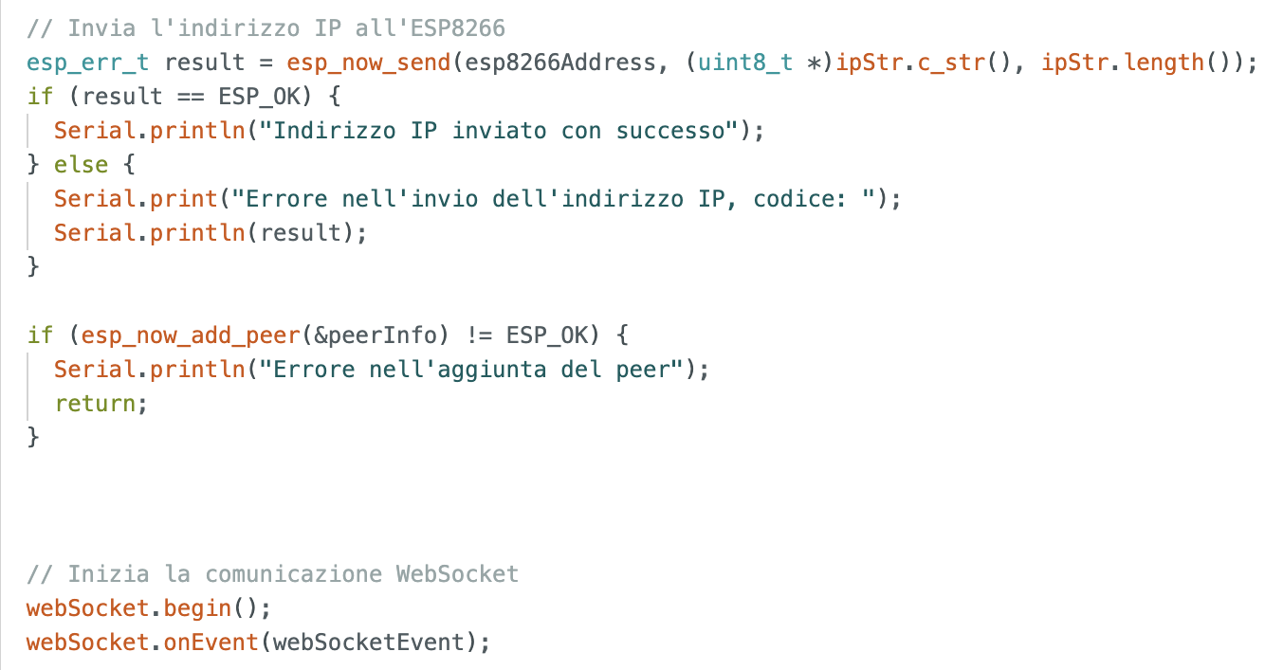
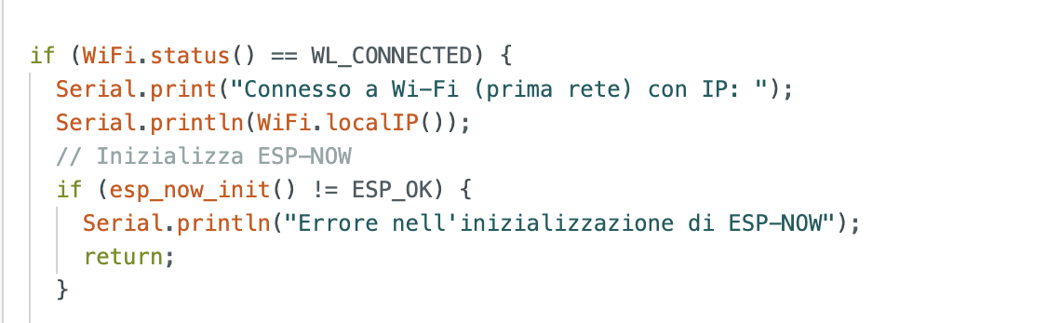
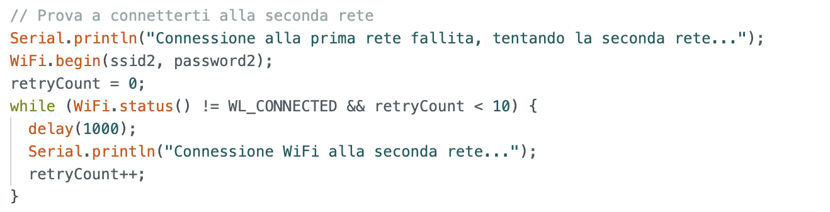
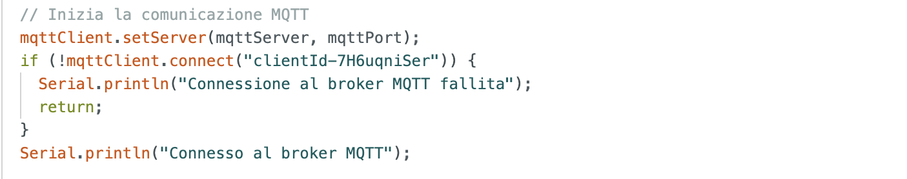
Interfacing between ESP32 and ESP8266 based on client location
In this step of the project, the system must recognize if it is connected to the main network.
If this happens, it will choose a protocol based on Websockets, otherwise it will establish a connection with an intermediate mqtt broker to send messages.
This mechanism is used to implement reliability to the system even when the subject is out of range of the main network.

Slide 7
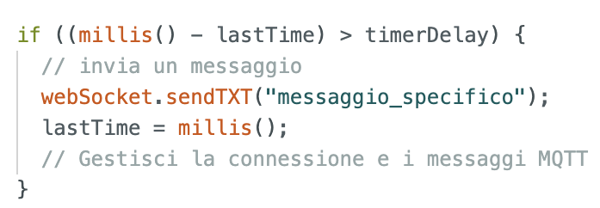
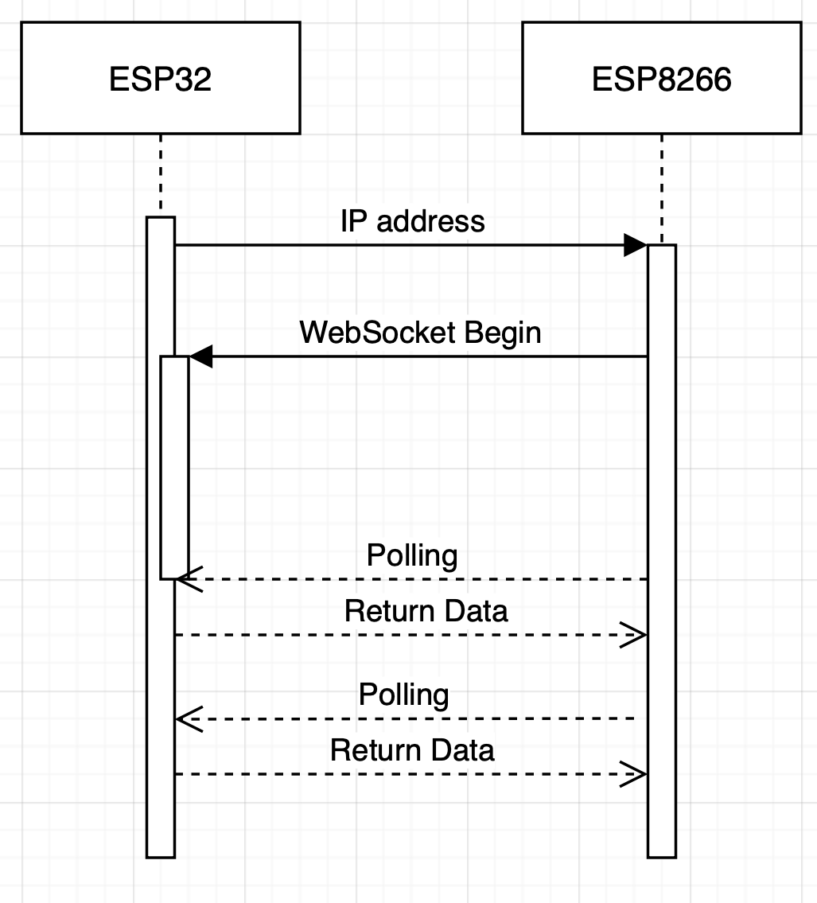
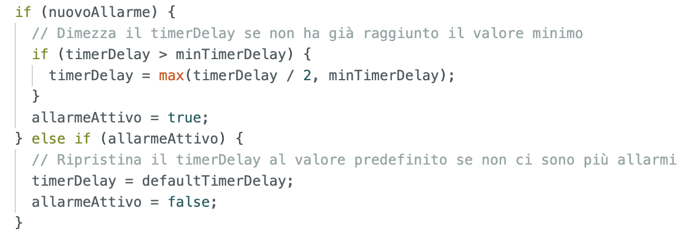
Interfacing between ESP32 and ESP8266 based on client location
In case the device belongs to the first network, a connection will take place via WebSocket managed by a timer that will give the time to the master's polling message.
The timer is initially set to 5 seconds, if no alarm data is found, if an alarming data is found then this timer is halved, taking the next 10 measurements faster than before.
If, after these 10 measurements, the alarm persists, the timer is halved again (and so on until a minimum threshold), otherwise it is reset to 5 seconds.
Inside the indoor context this energy saving mechanism has been implemented in order to save energy and extend the life of the system powered by a limited energy source.
This system allows to reduce energy consumption when the project does not need to send data using Wi-Fi but keeps the microprocessor active, in this way it can continue to process the data.

Slide 8
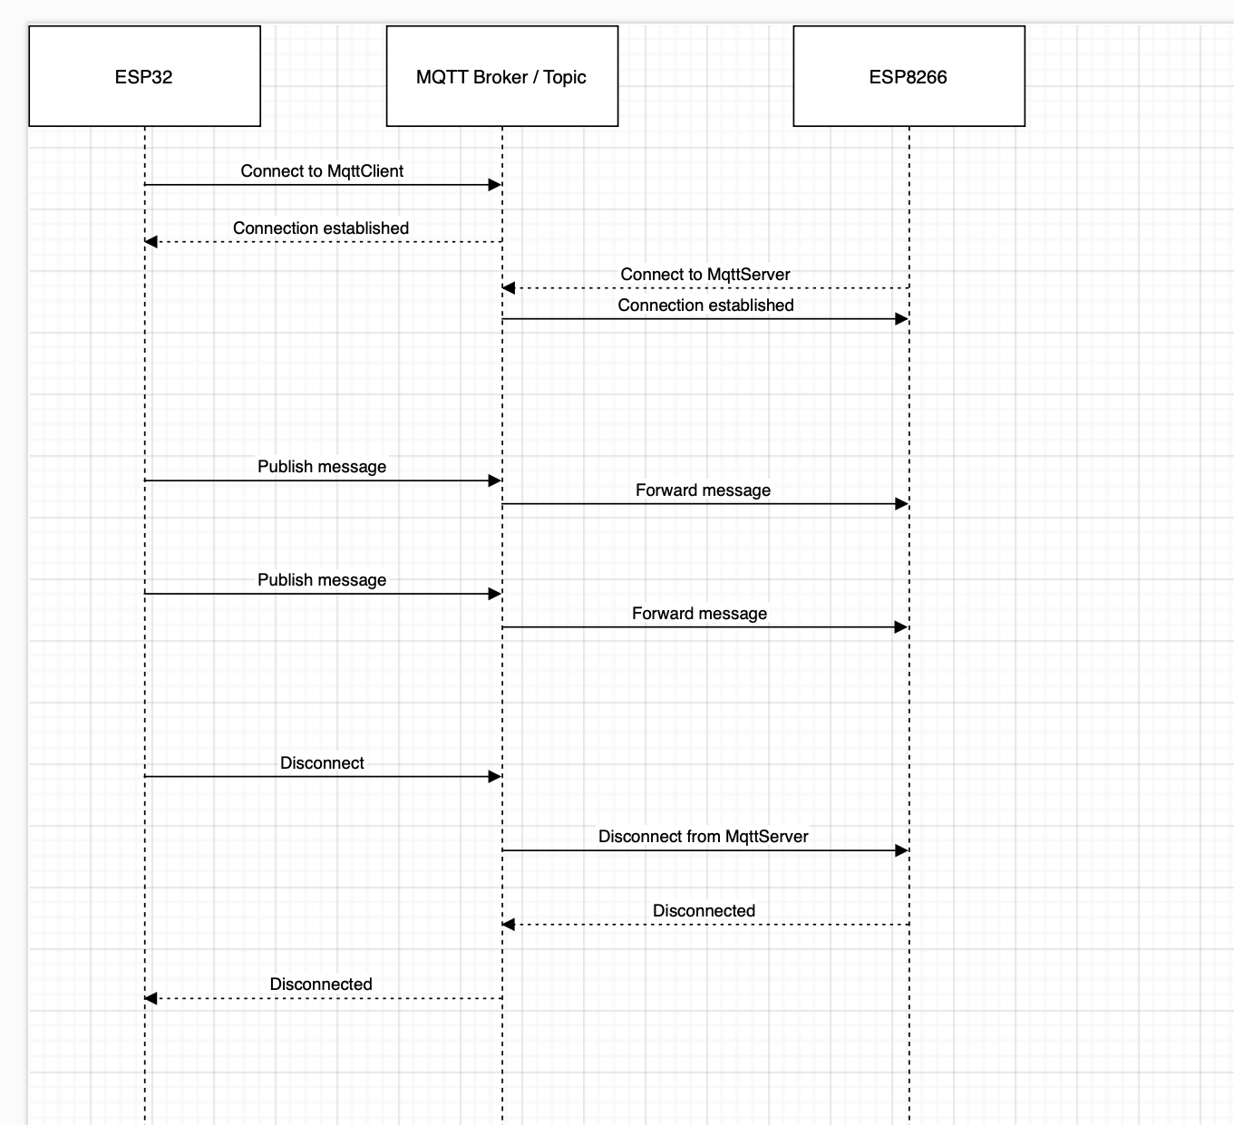
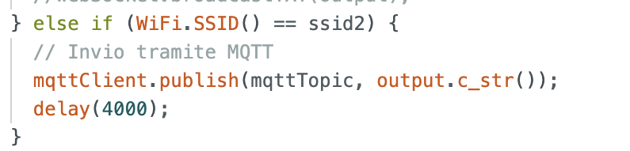
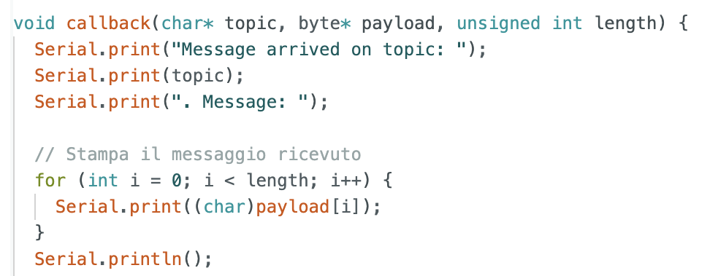
Interfacing between ESP32 and ESP8266 based on client location
Instead, if the system fails to connect to the primary network, and this would mean that the subject is outside the area of ​​the first network, a mechanism comes into play that causes the device to connect to the subject's personal hotspot and uses this connection to send data to an intermediate MQTT server, thus changing the communication protocol and establishing a data exchange at regular intervals.
The master will connect to the broker as a subscriber and will receive and process the data as in the previous case.

Slide 9
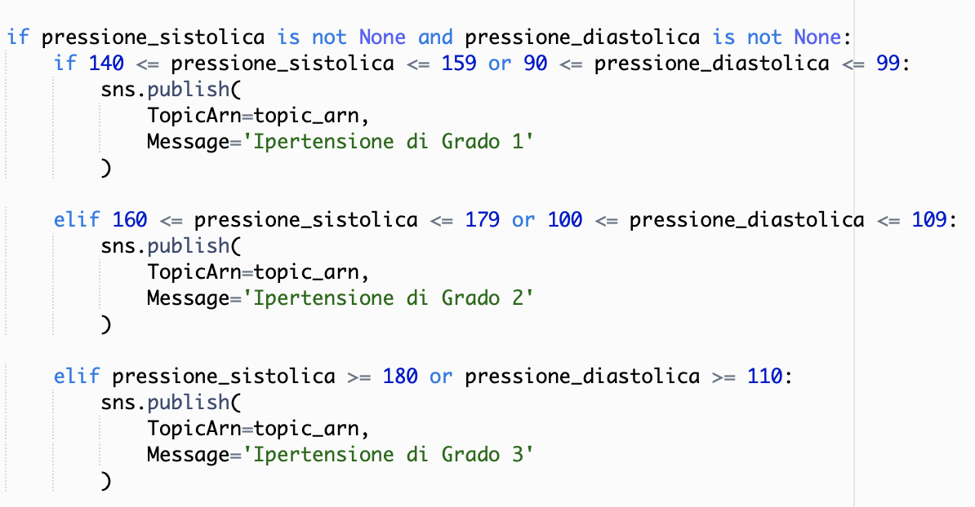
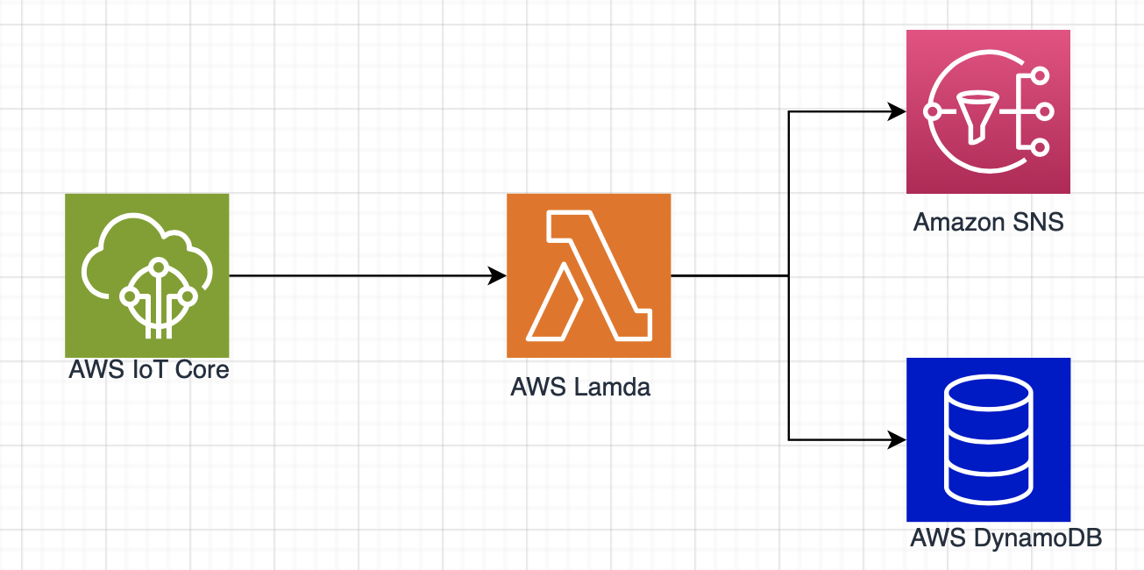
Data Managing on Cloud
AWS services take care of receiving data already previously processed by the device, saving them in a database by providing a timestamp, thus obtaining a view of the data over time.
The data is extracted from the JSON file and each value is saved inside some local variables.
It then manages the if conditions that allow the data sent by the device to be compared with the optimal values. In the event that these values ​​do not respect the optimal values, an SNS service will take care of sending notifications, using different types of notifications. .
In this case, design choices were made dictated by the characteristics of the services that best suited the needs of the project.
DynamoDB was chosen as the database service as it provides high scalability and is a service completely managed by the provider.
For the notification service, notification by e-mail was chosen, sacrificing a bit of practicality compared to SMS, but gaining in terms of speed of the service, in fact the notification via e-mail arrives at its destination almost instantly, while the service SMS takes about ten seconds.

Slide 10
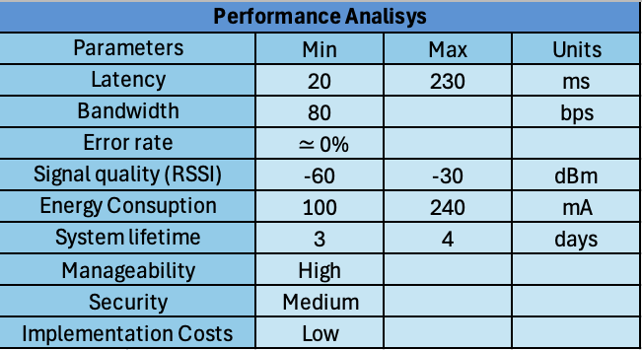
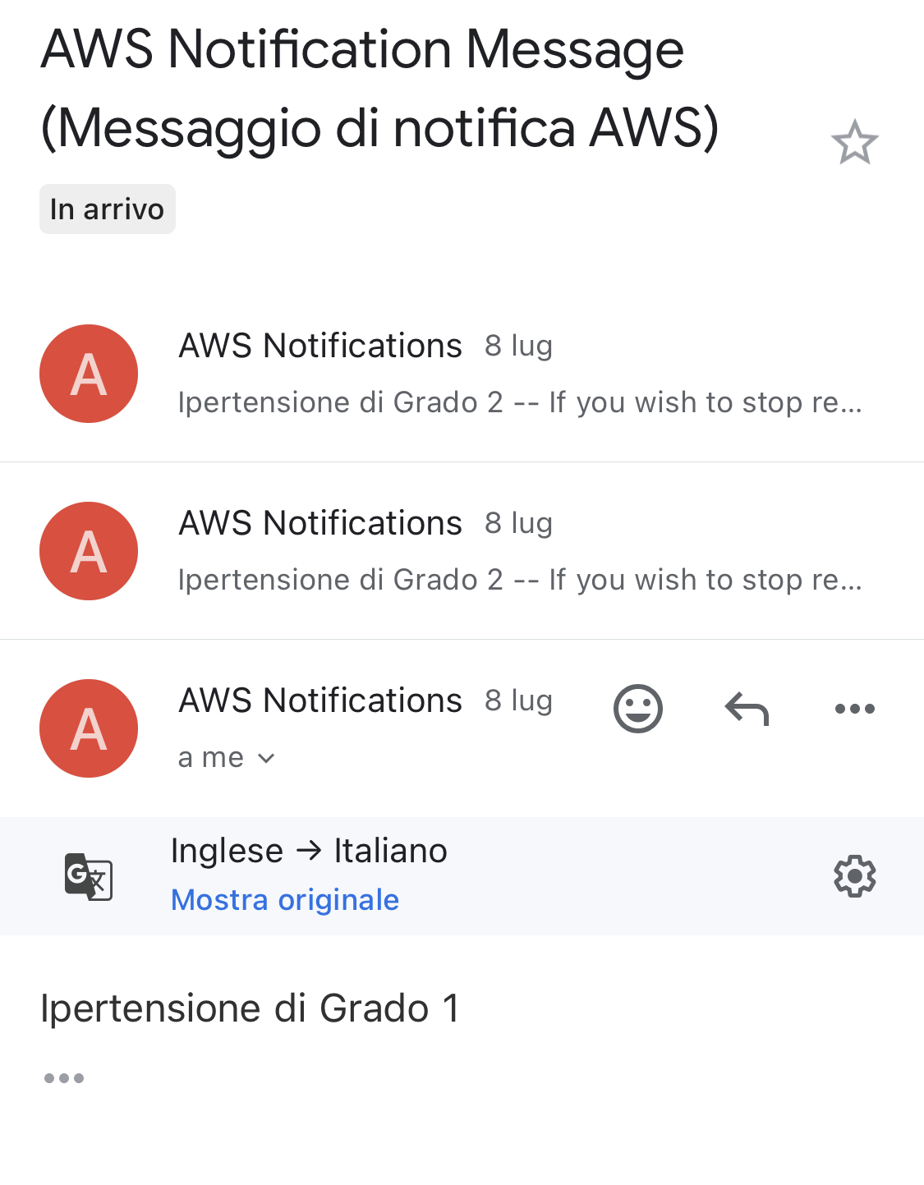
Results and conclusions
From the analysis of performance and results it is clear that the system operates with a variable latency depending on the distance between the two devices but has an excellent signal quality even at the edges of the field.
Furthermore, the system allows excellent data reliability thanks to a very low error rate.
The average level of security is given by the data transmitted via websocket (and the passage through a public MQTT broker), but they could be easily solved by implementing data encryption and the insertion of credentials for access to the intermediate broker.

